Slide 1
El Nino Preparedness
Group S Project Proposal
Samantha Aitkens
Asmaa Maoulainine
Kylota Stewart
Mizanur Rahman

Slide 2




Meet the Team
Notes:
Maybe just have a slide with our static images on it (could do little gifs if we wanted to get fancy) and have our name at the bottom of each image.

Slide 3
The Problem: Increasing Preparedness For the Next El Nino Climate Phenomenon in Ecuador
We will use existing data to learn from past storms and determine how to build resilience for future ones.
We will also look at El Nino and La Nina weather patterns to see if any correlations can be established based on the trends.
With this data we will be able to provide recommendations for future weather events facing Ecuador.

Slide 4
Introduction
DEFINITION
*El Niño is defined by National Geographic as a climate pattern describing the unusual warming of surface waters in the eastern equatorial Pacific Ocean.
IMPACTS
*The impacts of El Niño extend to:
-trade winds and atmosphere
-ocean temperatures,
-the speed and strength of ocean currents,
- the health of coastal fisheries,
-local weather from Australia to South America and beyond.
PERIODICITY
*El Niño events occur irregularly at two- to seven-year intervals.
HISTORY OF THE EL NINO CLIMATE PHENOMENON
El Niño events of 1982-83 and 1997-98 were the most intense of the 20th century.

Slide 5
Introduction
DESCRIPTION OF EL NINO CLIMATE PATTERNS
*El Niño events are defined by their wide-spread teleconnections, which are large-scale, long-lasting climate anomalies or patterns that are related to each other and can affect much of the globe.
PROBLEMS RAISED BY EL NINO
*During an El Niño event, changes in air pressure and wind speed disrupt cold water thrust. This interrupts the productivity of the coastal ecosystem. Fish populations die or migrate which devastates the economy.
*There can be severe climate changes like rains and floods which may destroy homes, schools, hospitals, and businesses. They also limit transportation and destroy crops.
*Stronger El Niño events also disrupt global atmospheric circulation. That is the large-scale movement of air that helps distribute thermal energy across the surface of Earth.

Slide 6
Objectives
Pull and analyze the last 50 years of weather data for Ecuador
Cast predictions from previous data to predict strength and
location of next storm
Develop evacuation plans
Develop food/water plans
Develop sanitation for emergency housing plans

Slide 7
Datasets
https://climateknowledgeportal.worldbank.org/country/ecuador
This site provides multiple data sets in which we can look at historical temperatures & precipitation as well as recent and predicted numbers.
https://climatedata.imf.org/pages/climatechange-data/#cc1
This data set focuses on changes in sea level. We cleaned the data to
just show Pacific Ocean data to focus on our specific region.
https://www.fao.org/faostat/en/#data/ET
This is where most of our data comes from as most sites use this as their
source for the section of data we looked over.

Slide 8
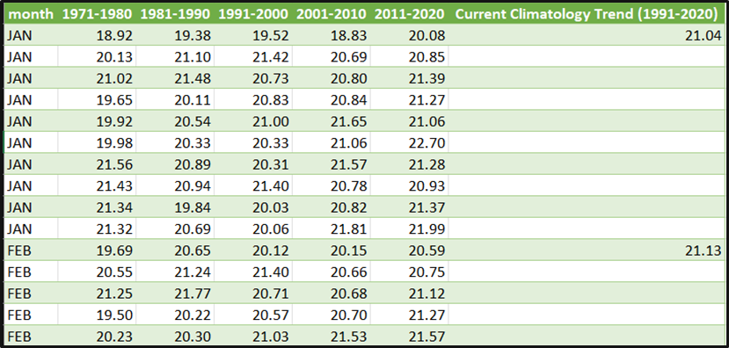
Examples of Data: CCKP

Slide 9
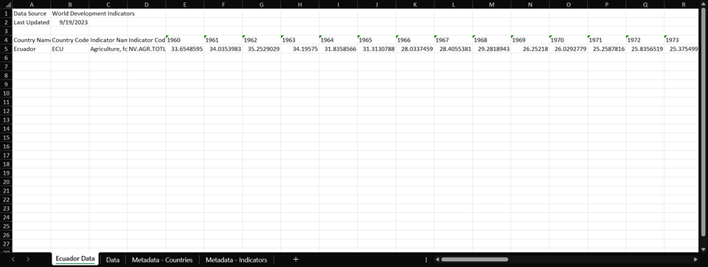
Examples of Data: WDI

Slide 10
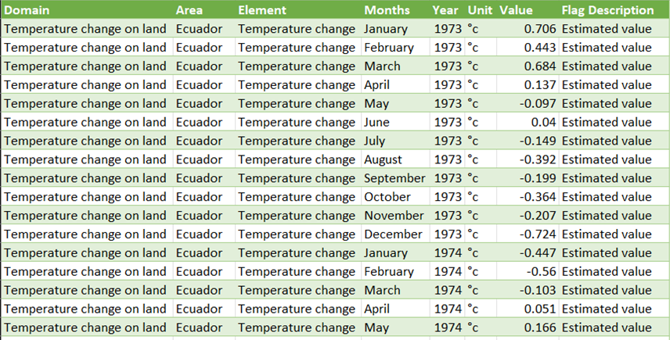
Examples of Data: FAOSTAT

Slide 11
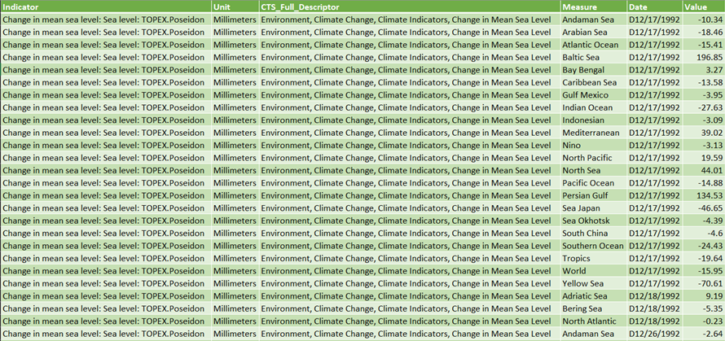
Examples of Data: Climate Change Dashboard-IMF

Slide 12
Tools
Data Processing and Analysis
Python with Pandas, Numpy
Visualization Tools:
Tableau
Power BI
Python libraries such as, MatplotLib, Seaborn & Plotly

Slide 13
Regression analysis based on the historical data after splitting the data as Train and Test data.
Then, prediction will be made about the future.
Last, visualization of patterns.
Data Analysis

Slide 14
Conclusion
With this knowledge, we will be able to reach a higher state of preparedness so that future El Nino and La Nina storms will not be as devastating.
Once this is done, future works should build on this foundation and follow the model to pull data about the polar ice caps melting and determine how fast they have been melting, and determine the rate of increase, and use this to cast prediction for how fast the ice caps will melt, when they will be completely gone, and how high sea levels might rise.
With this information, we can protect people and planet from the dire future predicted by the movie “2012”.

Slide 15
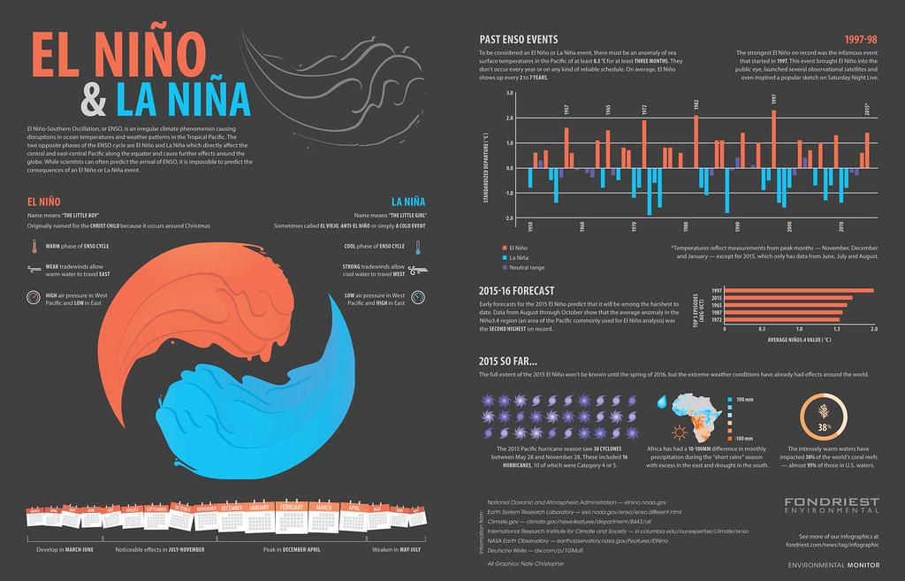
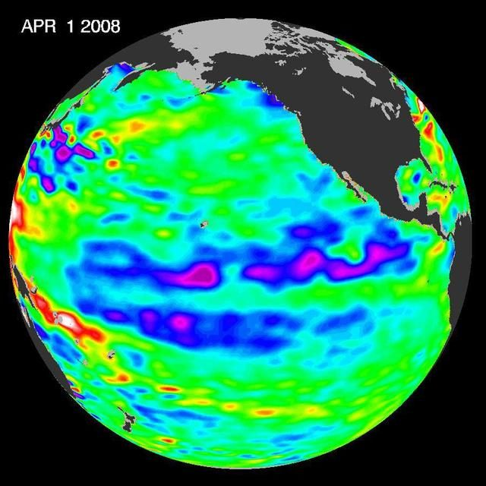
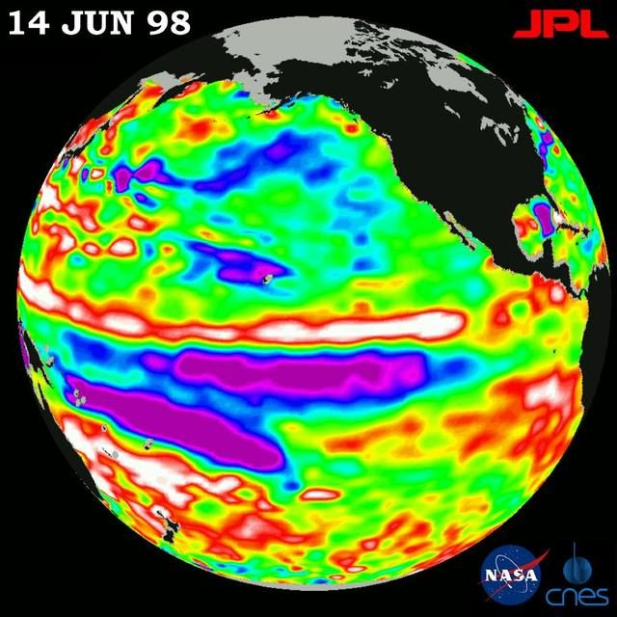
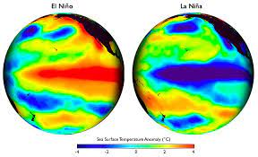
Conclusion 2

Slide 16
References
https://climateknowledgeportal.worldbank.org/country/ecuador
https://climatedata.imf.org/pages/climatechange-data/#cc1
https://www.fao.org/faostat/en/#data/ET
https://education.nationalgeographic.org/resource/el-nino/
https://www.weather.gov/ama/elnino
https://nhess.copernicus.org/articles/23/1507/2023/
https://reliefweb.int/report/world/el-nino-anticipatory-action-and-response-plan-august-december-2023-mitigating-expected-impacts-el-nino-induced-climate-extremes-agriculture-and-food-security

Slide 17
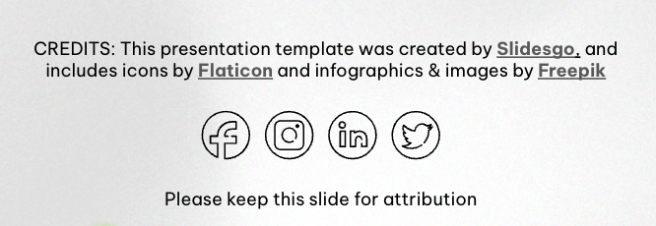
Resources
Did you like the resources in this template? Get them for free at our other websites:
Vectors
Gradient heat map background I
Gradient heat map background II
Hand drawn layers of the earth
Realistic grainy texture
Photos
Weather effects with dessert and trees
Weather effects with volcanic eruption
Man holding paper with green energy
Business person planning for alternative energies

